Slide 1



Classification
PG Certificate Course in Data Science, AI/ML and Data Engineering
by IIT Roorkee

Slide 2
Agenda
Introduction
Build Model with MNIST Dataset
Performance Measures
Cross Validation
Confusion Matrix
Precision & Recall
Precision/Recall Trade-off
ROC Curve
Type of Classification
Multi Class
Multi Label
Multi Output

Slide 3

What is Classification ?
Classification
Supervised
Regression
Human Supervision?
Unsupervised
Reinforcement
Machine Learning
Learn Incrementally?
How they generalize?

Slide 4
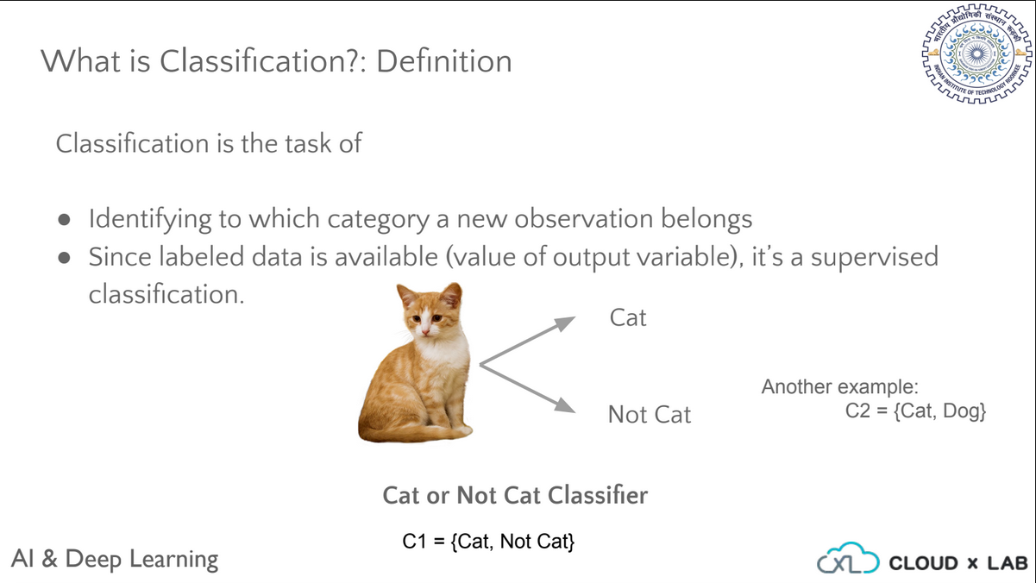
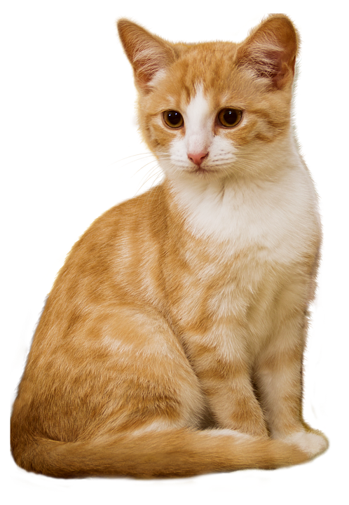
What is Classification?
Classification is the task of
Identifying to which category a new observation belongs
Cat
Not Cat
Cat or Not Cat Classifier
Notes:
Let’s see one more example. Say we have to build a model which classifies the images into dogs or cats. Each image in the training set has a label such as a cat or a dog. We feed these labeled images to the algorithm. The algorithm learns from the features of these images and builds the model. Since here we are feeding labeled images to the algorithm, such a classification is a supervised machine learning task.

Slide 5


What is Classification ?
Ham
Spam Filter
Incoming Emails
Spam
Spam Classifier
Notes:
Let’s see one more example. Say you have built the spam classifier which classifies the given email into spam or ham with

Slide 6
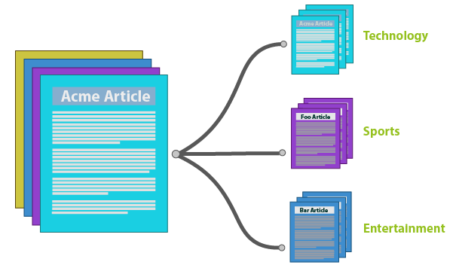
What is Classification ?
News Article Classifier

Slide 7
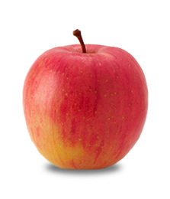

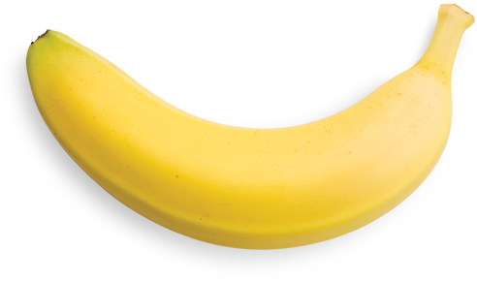
What is Classification ?
Apple
Banana
Images without Label
Model’s Predictions
Model
Fruits Classifier

Slide 8
So how does classification training works?

Slide 9


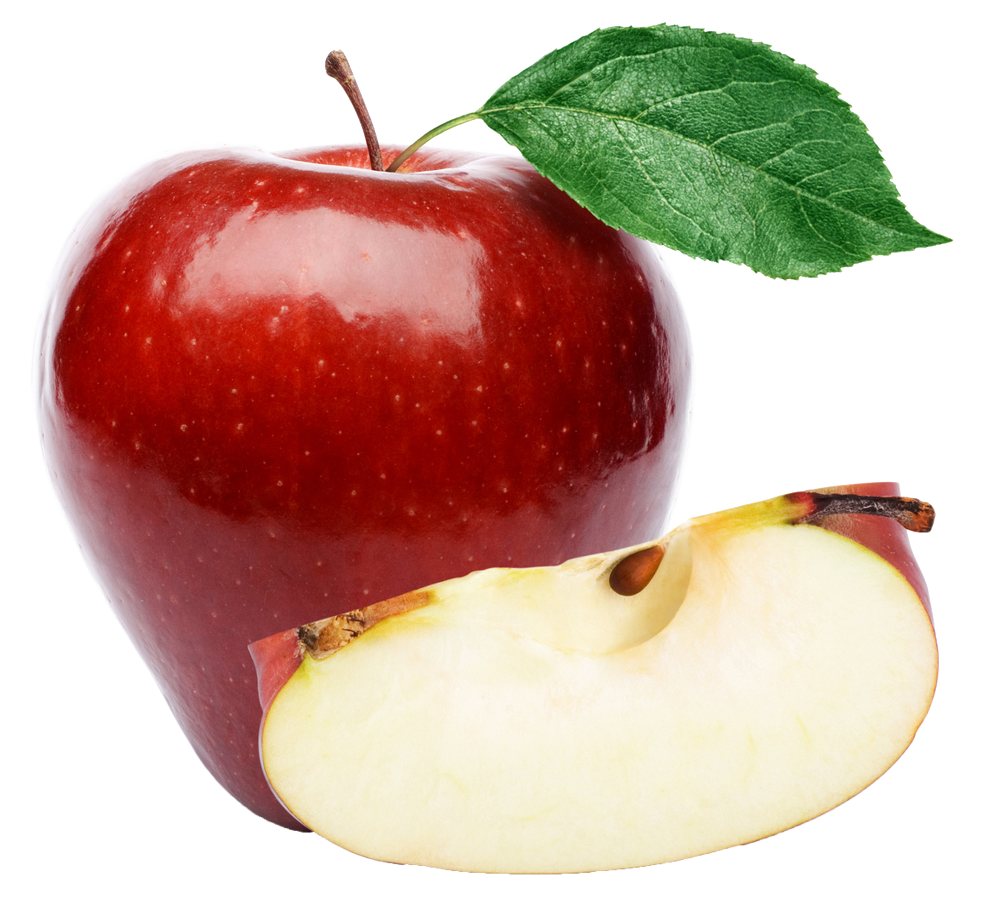
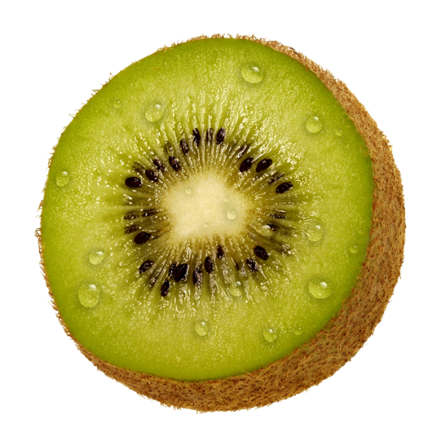
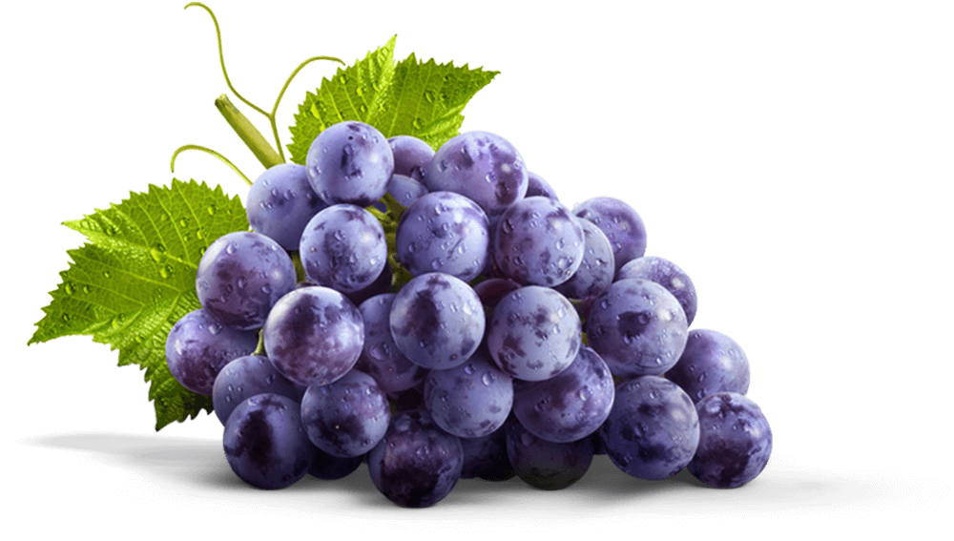
Labeled Images for Building Model
Apple
Banana
Apple
Kiwi
Grapes
Notes:
Say our task is to build a model which classifies the given image into fruits like Banana, Apple, and Kiwi. Here we have labeled images for training the model. Each image has a label such as Apple, Banana or Kiwi. Since we have labeled data such a classification will be supervised machine learning task.

Slide 10

Labeled Images for Building Model
Apple
Banana
Apple
Kiwi
Grapes
Algorithm
Training Phase
Notes:
We feed these labeled images to the algorithm. The algorithm learns from these labeled images and

Slide 11
Labeled Images for Building Model
Apple
Banana
Apple
Kiwi
Grapes
Algorithm
Training Phase
Model
Notes:
builds the model.

Slide 12
Predictions
Apple
Banana
Images without Label
Model’s Predictions
Model
Fruits Classifier
Notes:
Then this model can be used to classify new images into one of the fruits.

Slide 13
So how do we train the model in classification?

Slide 14
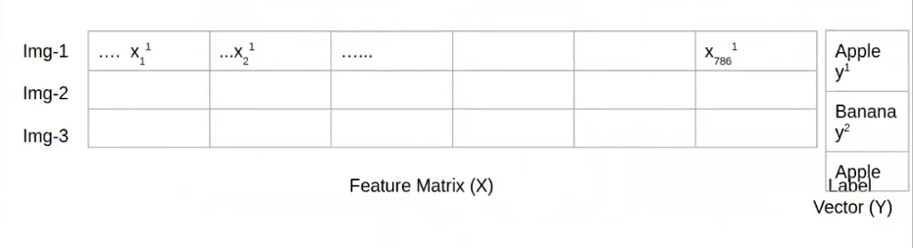
Labeled Images for Building Model
Apple
Banana
Apple
Kiwi
Grapes
Notes:
We first represent the images in the tabular form - In the form of rows and columns. We will soon revisit how to convert an image into tabular form.

Slide 15
Labeled Images for Building Model
Apple
Banana
Apple
Kiwi
Grapes
Split images into training and test set
Apple
Banana
Grapes
Kiwi
Apple
Training Set - 80% Data
Test Set - 20% Data
Notes:
Then we split the data into training and test set in the 80 20 ratio.

Slide 16
Labeled Images for Building Model
Apple
Banana
Apple
Kiwi
Grapes
Split images into training and test set
Apple
Banana
Grapes
Kiwi
Apple
Training Set - 80% Data
Test Set - 20% Data
Using training set we build the model
Notes:
and then using training set we build the model and

Slide 17
Labeled Images for Building Model
Apple
Banana
Apple
Kiwi
Grapes
Split images into training and test set
Apple
Banana
Grapes
Kiwi
Apple
Training Set - 80% Data
Test Set - 20% Data
Using test set we evaluate performance of model
Notes:
using the test set we evaluate the performance of the model.

Slide 18
Classification Types
Cat
Apple
Banana
Not Cat
Kiwi
Binary Classification - Two Classes
Multi Class Classification - Multiple Classes
Notes:
And then we deploy the model to production where it classifies the unknown new images into one of the fruits.

Slide 19
The goal of this session is to build a model to classify handwritten digits

Slide 20
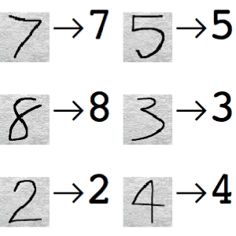
Handwritten Digits Classifier
0
1
2
3
4
5
6
7
8
9
Model classifies the image into one of the digits between 0 and 9
Input image
Model
Multiclass Classification
Model’s prediction
Notes:
Let’s build a classifier or model using MNIST dataset which classifies an image into one of the digits between 0 and 9. For example, here the model classified the image as class 5. This type of classification is known as multiclass classification where the model classifies the object into one of the multiple classes. How do we train such model?

Slide 21

Handwritten Digits Classifier - Dataset
Source: http://yann.lecun.com/exdb/mnist/
In this problem, we will use MNIST dataset
Set of 70,000 small images
Each image is grayscale (black & white)
28 by 28 pixels
The digits have been size-normalized and centered in a fixed-size image.
MNIST Dataset
(Modified National Institute of Standards and Technology)
Notes:
About MNIST data set

Slide 22
Handwritten Digits Classifier - Dataset
Every Image has Label Associated
Notes:
Let’s revisit the MNIST dataset from the topic “Representing data”. The MNIST dataset consists of 70,000 small images of digits handwritten by high school students and employees of the US Census Bureau. As you can see each image is labeled with the digit it represents. The MNIST dataset is considered the “Hello Word” of machine learning. Whenever people come up with a new classification algorithm they are curious to see its performance on the MNIST dataset.

Slide 23
Handwritten Digits Classifier - Dataset
MNIST dataset is also called
“Hello World” of Machine Learning
We have to build a model using this labelled dataset
Every Image has Label Associated
Notes:
Let’s revisit the MNIST dataset from the topic “Representing data”. The MNIST dataset consists of 70,000 small images of digits handwritten by high school students and employees of the US Census Bureau. As you can see each image is labeled with the digit it represents. The MNIST dataset is considered the “Hello Word” of machine learning. Whenever people come up with a new classification algorithm they are curious to see its performance on the MNIST dataset.

Slide 24
Handwritten Digits Classifier - Dataset
Let’s get the data and explore it
Go to Jupyter
Open New Terminal
Switch to the repository
cd iitr-deep-learning-spl-tf2
Get the latest code
git pull origin master
Notes:
About MNIST data set

Slide 25
Handwritten Digits Classifier - Dataset
Fetch the Data
>>> from sklearn.datasets import fetch_openml
>>> mnist = fetch_openml('mnist_784', version=1)
>>> X, y = mnist["data"], mnist["target"]
Notes:
About MNIST data set

Slide 26
Handwritten Digits Classifier - Dataset
So how do we start the training process?
Notes:
Let’s revisit the MNIST dataset from the topic “Representing data”. The MNIST dataset consists of 70,000 small images of digits handwritten by high school students and employees of the US Census Bureau. As you can see each image is labeled with the digit it represents. The MNIST dataset is considered the “Hello Word” of machine learning. Whenever people come up with a new classification algorithm they are curious to see its performance on the MNIST dataset.

Slide 27
Handwritten Digits Classifier - Training Process
???
Tabular form - Rows and Columns
Notes:
Now, the question is how do we represent images in the tabular form so that we can feed them to the algorithm.

Slide 28
Handwritten Digits Classifier - Training Process
???
Instances, Features and Labels?
Notes:
Also, what are the features and label

Slide 29
Handwritten Digits Classifier - Training Process
Each image is an instance
Notes:
There are seventy thousand images in the MNIST dataset so the number of instances are seventy thousand.

Slide 30
Handwritten Digits Classifier - Training Process
Label
Notes:
Each image has a label associated with it.

Slide 31
Handwritten Digits Classifier - Training Process
Features?
Notes:
Let’s see how do we represent these images in the tabular form.

Slide 32
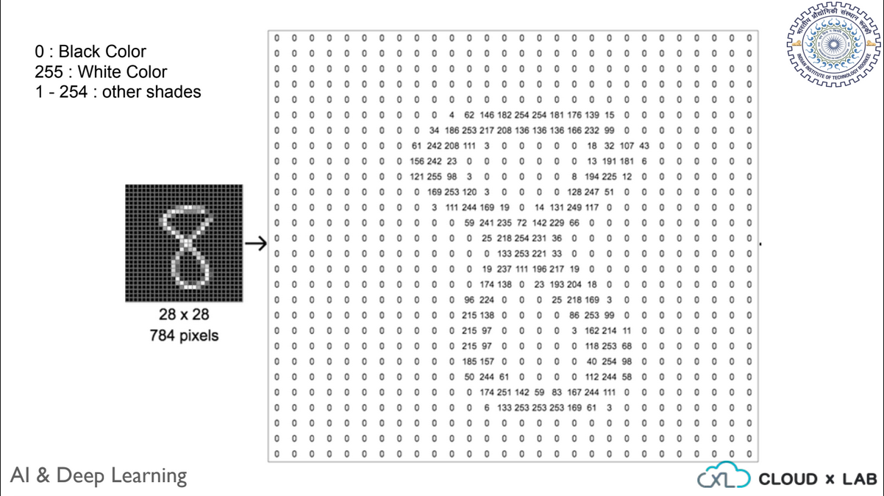
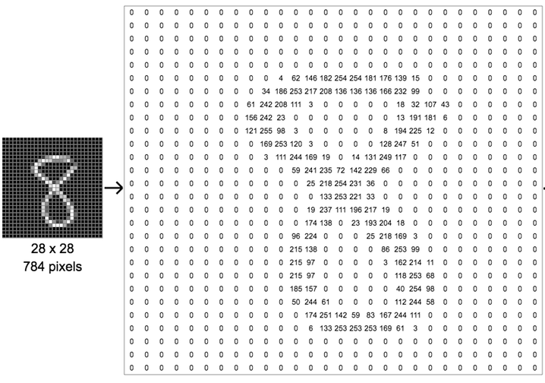
Notes:
Each image in the MNIST is of size 28 by 28. Also, each image is grayscale or in other words black-and-white. Such an image is basically a two-dimensional array of numbers. The black color is represented as 0 and white is represented as 255 and other shades in between. So, an image is a two-dimensional matrix of numbers. The are many ways of converting a two-dimensional image into a one-dimensional array or list of numbers. For now, we will take a simple approach whereby we will append all rows and make a single dimension array.

Slide 33
Handwritten Digits Classifier - Training Process
Model
Input data in tabular form - Includes both features and labels
Algorithm
Notes:
We feed this data to the algorithm and the algorithm builds the model.

Slide 34

Fetching MNIST dataset in Scikit-Learn
Looking at one of the data samples
>>> %matplotlib inline
>>> import matplotlib as mpl
>>> import matplotlib.pyplot as plt
>>> some_digit = X[0]
>>> some_digit_image = some_digit.reshape(28, 28)
>>> plt.imshow(some_digit_image, cmap=mpl.cm.binary)
>>> plt.axis("off")
>>> plt.show()
Switch to Notebook

Slide 35

Fetching MNIST dataset in Scikit-Learn
Looking at one of the data samples
Switch to Notebook

Slide 36
Handwritten Digits Classifier - Training Process - Steps
Divide dataset into training and test samples
Train the classifier using training dataset
Test using test dataset
Performance metrics (Finalize the model)

Slide 37
Training and Test dataset
Training Dataset
(60, 000 images)
Entire dataset
(70, 000 images)
Test Dataset
(10, 000 images)

Slide 38
Dividing dataset into training and test samples
Dividing dataset into training and test in python:
>>> X_train, X_test, y_train, y_test = X[:60000], X[60000:], y[:60000], y[60000:]
Switch to Notebook

Slide 39
Steps
Divide dataset into training and test samples
Train the model using training dataset
Test using test dataset
Performance metrics (Finalize the model)

Slide 40
Train the Classifier using Training Dataset
0
1
2
3
4
5
6
7
8
9
Model classifies the image into one of the digits between 0 and 9
Input image
Model
Multiclass Classification
Model’s prediction

Slide 41
Train the Classifier using Training Dataset
For simplicity, let’s first train a binary classifier instead of multiclass classifier
Notes:
1 denotes the class 5. Now the label also contains numbers.

Slide 42
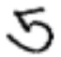
Train the Classifier using Training Dataset
We will train a binary classifier called 5-detector
5
Not 5
Input: Image
Output: Classification
5 - Detector
Notes:
1 denotes the class 5. Now the label also contains numbers.

Slide 43
Train the Classifier using Training Dataset
Lets change our training and test set labels in MNIST to train 5 detector
>>> y_train_5 = (y_train == 5) # True for all 5s, False for all other digits
>>> y_test_5 = (y_test == 5) # True for all 5s, False for all other digits
Notes:
1 denotes the class 5. Now the label also contains numbers.

Slide 44
Train the Classifier using Training Dataset
We are going to use: Stochastic Gradient Descent (SGD) Classifier
Notes:
http://scikit-learn.org/stable/modules/sgd.html

Slide 45
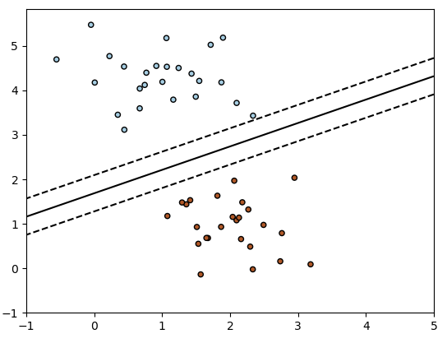
SGD - Stochastic Gradient Descent Classifier
For the two-dimensional (2 features) training dataset,
Trying to estimate the coefficients of the line which can be
Best-fitted dividing the two categories
Class: 0
SGD Classifier
Class: 1

Slide 46
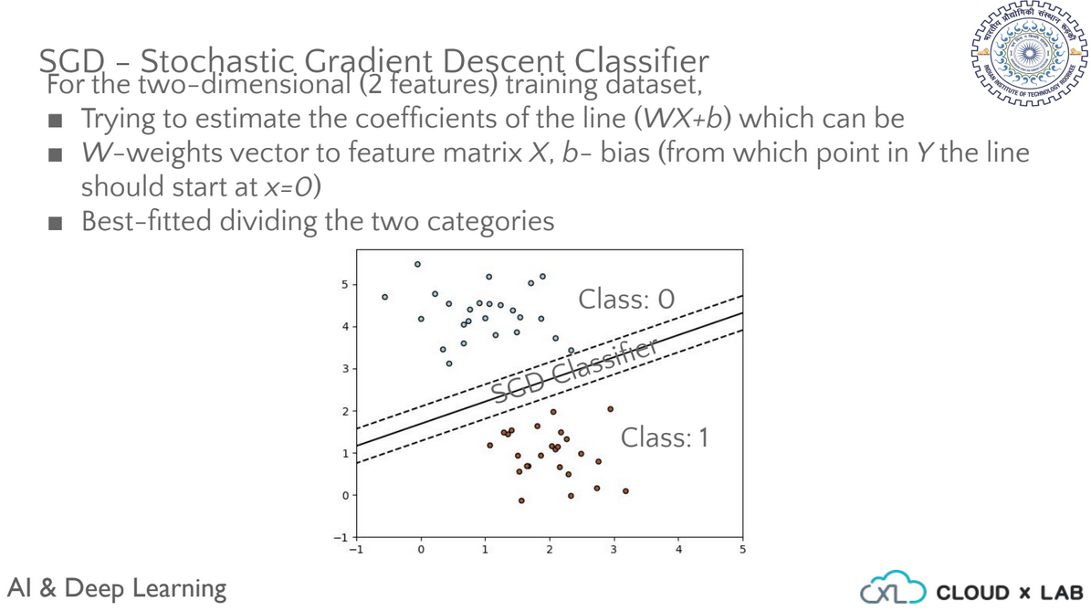
SGD - Stochastic Gradient Descent Classifier
For the two-dimensional (2 features) training dataset,
Trying to estimate the coefficients of the line which can be
Best-fitted dividing the two categories
Class: 0
SGD Classifier
Class: 1

Slide 47
SGD - Stochastic Gradient Descent Classifier
Stochastic Gradient Descent (SGD) Classifier
Capable of handling large datasets
Well suited for online training

Slide 48
Training SGDClassifier
Original problem: ‘5’ and ‘Not 5’ classifier
>>> from sklearn.linear_model import SGDClassifier
>>> sgd_clf = SGDClassifier(random_state=42)
>>> sgd_clf.fit(X_train, y_train_5)

Slide 49
Steps
Divide dataset into training and test samples
Train the classifier using training dataset
Test using sample data
Performance metrics (Finalize the model)

Slide 50
Testing SGDClassifier
First image stores the digit 5 and the classifier correctly classifier it as ‘True’
>>> some_digit = X[0] # Taking the First image
>>> sgd_clf.predict([some_digit])
array([True], dtype=bool)

Slide 51
Steps
Divide dataset into training and test samples
Train the classifier using training dataset
Test using sample data
Performance metrics (Finalize the model)

Slide 52

Measuring Performance of Classifier
Cross Validation - Accuracy
Confusion Matrix
Precision
Recall
F1 score
ROC Curve

Slide 53
Steps
Divide dataset into training and test samples
Train the classifier using training dataset
Test using sample data
Performance metrics (Finalize the model)
Cross Validation - Accuracy
Confusion Matrix
Precision
Recall
F1 Score
ROC Curve

Slide 54
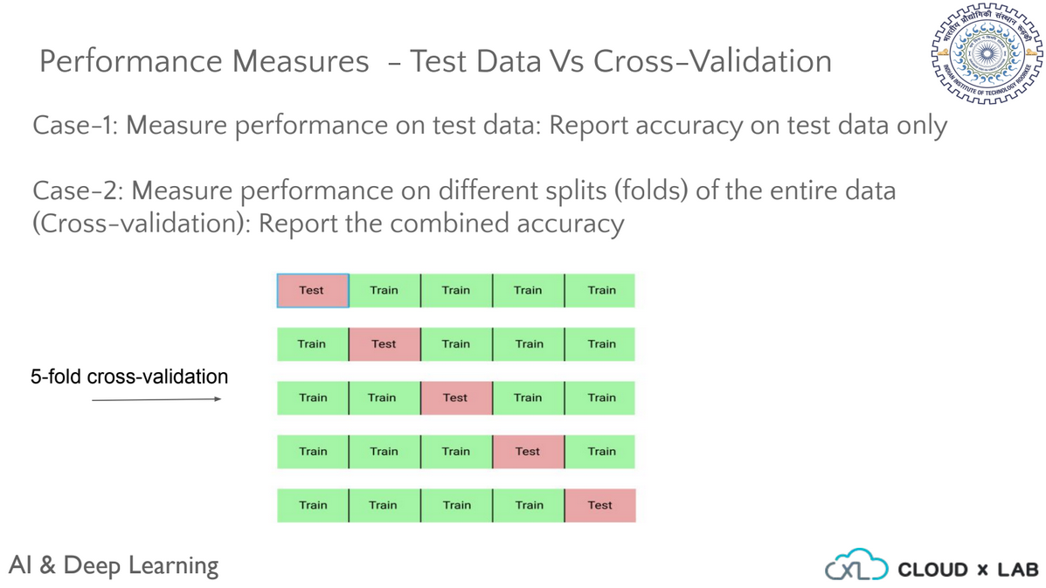
Performance Measures - Cross Validation
cross_val_score
As discussed in end-to-end project session, cross_val_score() function in scikit-learn can be used to perform cross validation

Slide 55
Performance Measures - Cross Validation
cross_val_score
As discussed in end-to-end project session, cross_val_score() function in scikit-learn can be used to perform cross validation

Slide 56
Performance Measures - Cross Validation
Initiating cross validation method
>>> from sklearn.model_selection import cross_val_score
>>> cross_val_score(sgd_clf, X_train, y_train_5, cv=3, scoring="accuracy")
Classifier object
Training data
Training Labels
Cross Validation
Scoring Parameter
Switch to Notebook

Slide 57
Performance Measures - Cross Validation
>>> array([0.95035, 0.96035, 0.9604 ])
The resulting accuracy is above 95 % for each of the folds

Slide 58
Performance Measures - Cross Validation
Is the accuracy of 95% good enough?

Slide 59
Performance Measures - Cross Validation
Is the accuracy of 95% good enough?
Let’s see

Slide 60
Performance Measures - Cross Validation
For Now Let’s Build Another Classifier - Never5Classifier - Which classifies every image as “Not 5”
Never5Classifier
Not 5
Not 5
Not 5

Slide 61
Performance Measures - Cross Validation
Never5Classifier
>>> from sklearn.base import BaseEstimator
>>> class Never5Classifier(BaseEstimator):
def fit(self, X, y=None):
pass
def predict(self, X):
return np.zeros((len(X), 1), dtype=bool)
Switch to Notebook

Slide 62
Performing Cross validation in Scikit learn
Calculating accuracy using cross_val_score
>>> never_5_clf = Never5Classifier()
>>> cross_val_score(never_5_clf, X_train, y_train_5, cv=3, scoring="accuracy")
Switch to Notebook

Slide 63
Performing Cross validation in Scikit learn
Accuracy = 95 %
Accuracy = 90 %
SGDClassifier
Dumb Classifier - Never5 Classifier

Slide 64
Skewed Dataset
90% Images - Other Than 5
Our Dataset
10% Images - of Digit 5
Skewed Dataset
Class Imbalance

Slide 65


Input
Model’s Prediction
90% Images - Other Than 5
Not 5
10% Images - of Digit 5
Dumb Classifier - Classifies every image as “Not 5”
Not 5
Accuracy → 90%

Slide 66
Learnings??
Accuracy may not be a good performance measure when dealing with skewed datasets

Slide 67

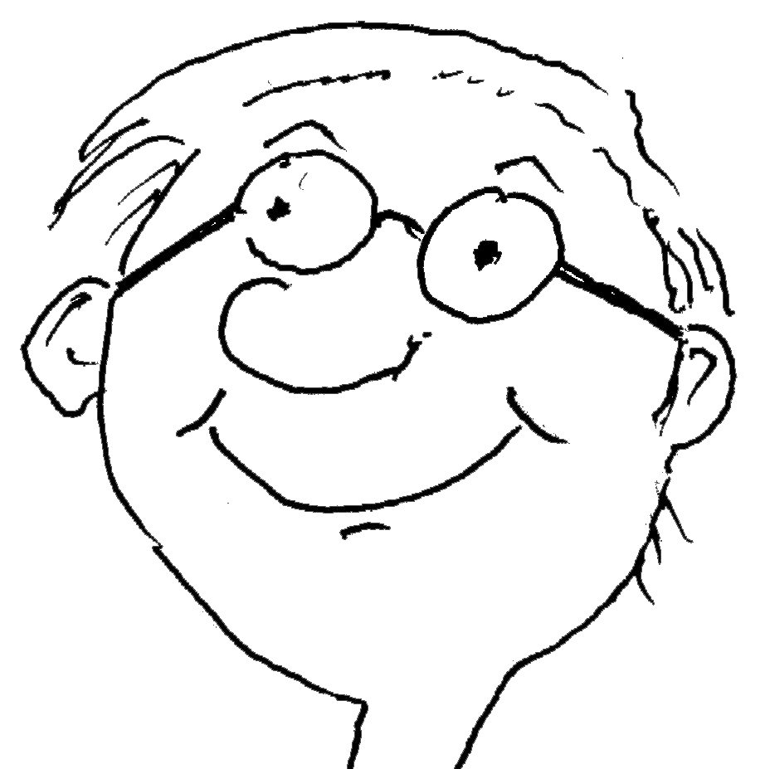

Question - Let’s say your friend has built a model which classify an image into a male or female with 99% accuracy. What questions you will ask your friend to make sure his model is fine?
Classifier
99% Accuracy
Input
Questions???
Notes:
….questions will you ask your friend to make sure if his classifier is really good? Pause the video for a minute and think about all the questions.

Slide 68





Labeled Images for Building Model
Male
Male
Male
Female
Male
%
Males
???
% Females ???
Question - Percentage of males and females in training dataset
Notes:
females images in the dataset?

Slide 69
Labeled Images for Building Model
Male
Male
Male
Female
Male
80%
Males
20% Females
Your friend answers 80% male and 20% females
Notes:
females images in the dataset?

Slide 70
Classifier
99% Accuracy
Input
Since dataset is skewed hence you will not trust his model

Slide 71
Performing Cross validation in Scikit learn
Accuracy = 95 %
Accuracy = 90 %
SGDClassifier
Dumb Classifier - Never5 Classifier
We need a better measure of performance for the classifier

Slide 72
Steps
Divide dataset into training and test samples
Train the classifier using training dataset
Test using sample data - some_digit
Performance metrics (Finalize the model)
Cross Validation - Accuracy
Confusion Matrix
Precision
Recall
F1 Score
ROC Curve

Slide 73
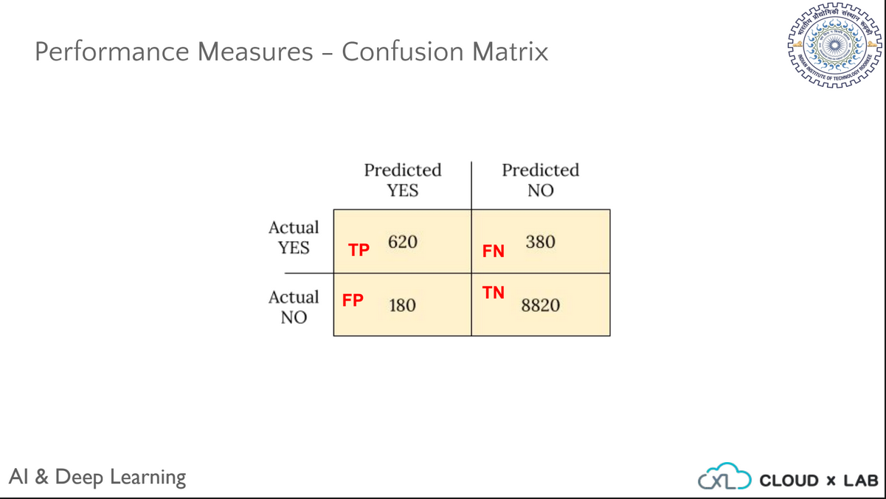
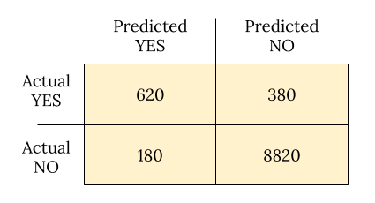
Performance Measures - Confusion Matrix
Notes:
A much better way to look into the performance of the classifier is to look at the confusion matrix. The general idea of the confusion matrix is to count the number of times instances of class A are classified as class B.

Slide 74
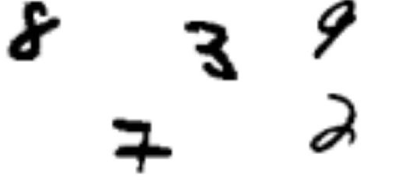
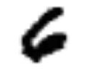
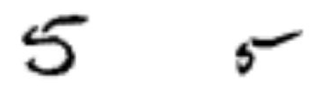
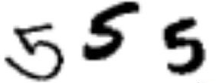
Predicted
 | Not-5s | 5s
Not-5s
5s
Actual
Sample Confusion Matrix of 5-Detector
Notes:
Here is the illustrated view of confusion matrix. Let’s understand the terms associated with the confusion matrix.

Slide 75
Predicted
TN
 | Not-5s | 5s
Not-5s
5s
Actual
TN - True Negatives
Notes:
True negatives are the cases in which images were correctly classified as not 5s. It includes the cases when the actual images were

Slide 76
Predicted
( Actual Image )
TN
 | Not-5s | 5s
Not-5s
5s
Actual
Not 5
TN - True Negatives
( Predicted Class )
Notes:
of not-5s and the model also classified them as not-5s.

Slide 77
Predicted
FP
 | Not-5s | 5s
Not-5s
5s
Actual
FP - False Positives
Notes:
False Positives are the cases in which images were wrongly classified as 5s. It includes cases when the actual images were

Slide 78
Predicted
FP
( Actual Image )
 | Not-5s | 5s
Not-5s
5s
Actual
5
FP - False Positives
( Predicted Class )
Notes:
of not-5s but the model classified them as 5s

Slide 79
Predicted
 | Not-5s | 5s
Not-5s
5s
Actual
FN
FN - False Negatives
Notes:
False Negatives are the cases in which the images were wrongly classified as non-5s. It includes cases when the actual images

Slide 80
Predicted
( Actual Image )
 | Not-5s | 5s
Not-5s
5s
Actual
Not 5
FN
FN - False Negatives
( Predicted Class )
Notes:
were of 5s but the model classified them as not-5s.

Slide 81
Predicted
 | Not-5s | 5s
Not-5s
5s
Actual
TP - True Positives
TP
Notes:
True Positives are the cases in which the images are correctly classified as 5s. It includes cases when the actual images

Slide 82
Predicted
( Actual Image )
 | Not-5s | 5s
Not-5s
5s
Actual
5
TP - True Positives
TP
( Predicted Class )
Notes:
were of 5s and the model also predicted them as 5s. Though confusion matrix gives us a lot of information we require more concise metric

Slide 83
Predicted
TN
FP
 | Not-5s | 5s
Not-5s
5s
Actual
FN
TP
Notes:
were of 5s and the model also predicted them as 5s. Though confusion matrix gives us a lot of information we require more concise metric

Slide 84
Steps
Divide dataset into training and test samples
Train the classifier using training dataset
Test using sample data - some_digit
Performance metrics (Finalize the model)
Improve the model using error analysis
Cross Validation - Accuracy
Confusion Matrix
Precision
Recall
F1 Score
ROC Curve
Notes:
were of 5s and the model also predicted them as 5s. Though confusion matrix gives us a lot of information we require more concise metric

Slide 85
Precision and Recall
Notes:
such us Precision and Recall. Let’s understand Precision and Recall.

Slide 86

Performance Measures - Precision
Precision means lack of mistakes
Notes:
In real-life, precision is marked by lack of mistakes..

Slide 87
Predicted
TN
FP
 | Not-5s | 5s
Not-5s
5s
Actual
Precision
FN
TP
what proportion of images that were classified as 5s were actually 5
Notes:
For the 5-detector, precision is the measure that tells us what proportion of images that were classified as 5s were actually 5.

Slide 88
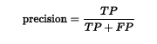
Predicted
TN
FP
 | Not-5s | 5s
Not-5s
5s
Actual
Precision
FN
TP
what proportion of images that were classified as 5s were actually 5
Notes:
For the 5-detector, precision is the measure that tells us what proportion of images that were classified as 5s were actually 5.

Slide 89
Predicted
TN
FP
 | Not-5s | 5s
Not-5s
5s
Actual
Precision -
3 out of 4
FN
TP
what proportion of images that were classified as 5s were actually 5
Notes:
So the precision is 3 out of 4. In other words, precision is about being precise. It measures how many classifications were correct out of the all the classifications. So if a model classifies only one image but classifies it correctly then its precision will be 100%.

Slide 90

Performance Measures - Recall
Recall means remember something learnt in past
Notes:
In real life, recall means to remember something learnt in the past.

Slide 91
Predicted
TN
FP
 | Not-5s | 5s
Not-5s
5s
Actual
FN
Recall
TP
what proportion of images that were actually 5 were predicted as class 5
Notes:
For 5-detector, recall is the measure of what proportion of images that were actually 5 were classified as class 5.

Slide 92
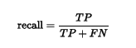
Predicted
TN
FP
 | Not-5s | 5s
Not-5s
5s
Actual
FN
Recall
TP
what proportion of images that were actually 5 were predicted as class 5
Notes:
So the recall is 3 out of 5. In other words, recall is about classifying all the images of 5 as 5s. Let’s take one more example to understand precision and recall.

Slide 93
Predicted
TN
FP
 | Not-5s | 5s
Not-5s
5s
Actual
FN
Recall - 3 out of 5
TP
what proportion of images that were actually 5 were predicted as class 5
Notes:
So the recall is 3 out of 5. In other words, recall is about classifying all the images of 5 as 5s. Let’s take one more example to understand precision and recall.

Slide 94
Steps
Divide dataset into training and test samples
Train the classifier using training dataset
Test using sample data - some_digit
Performance metrics (Finalize the model)
Improve the model using error analysis
Cross Validation - Accuracy
Confusion Matrix
Precision
Recall
F1 Score
ROC Curve
Notes:
were of 5s and the model also predicted them as 5s. Though confusion matrix gives us a lot of information we require more concise metric

Slide 95
Let’s see one more example of confusion matrix of model predicting if someone has cancer or not
Notes:
Here is the confusion matrix of the model which predicts if someone has cancer or not. Here precision is the measure which tells us

Slide 96
Performance Measures - Confusion Matrix
Predicted
TN
FP
 | Cancer - No | Cancer - Yes
Cancer - No | 50 | 10
Cancer - Yes | 5 | 100
Actual
FN
TP
What is Precision?
Notes:
Here is the confusion matrix of the model which predicts if someone has cancer or not. Here precision is the measure which tells us

Slide 97
Performance Measures - Confusion Matrix
Predicted
TN
FP
 | Cancer - No | Cancer - Yes
Cancer - No | 50 | 10
Cancer - Yes | 5 | 100
Actual
Total Predictions = 110
FN
TP
What is Precision?
Notes:
how many patients that model predicted as having cancers

Slide 98
Performance Measures - Confusion Matrix
Predicted
TN
FP
 | Cancer - No | Cancer - Yes
Cancer - No | 50 | 10
Cancer - Yes | 5 | 100
Actual
Correct Predictions = 100
FN
TP
What is Precision?
Notes:
actually have cancer. Here model predicted that ...

Slide 99
Performance Measures - Confusion Matrix
Predicted
TN
FP
 | Cancer - No | Cancer - Yes
Cancer - No | 50 | 10
Cancer - Yes | 5 | 100
Precision -
100 out of 110
= 0.91
Actual
FN
TP
What is Precision?
Notes:
So the precision is 100 out of 110 which is approximately 0.91.

Slide 100
Performance Measures - Confusion Matrix
Predicted
TN
FP
 | Cancer - No | Cancer - Yes
Cancer - No | 50 | 10
Cancer - Yes | 5 | 100
Actual
FN
TP
What is Recall?
Notes:
Recall is the measure which tells us what proportion of patients that...

Slide 101
Performance Measures - Confusion Matrix
Predicted
TN
FP
 | Cancer - No | Cancer - Yes
Cancer - No | 50 | 10
Cancer - Yes | 5 | 100
Actual
Total Patients Having Cancer = 105
FN
TP
What is Recall?
Notes:
actually had cancer was diagnosed by the model as...

Slide 102
Performance Measures - Confusion Matrix
Predicted
TN
FP
 | Cancer - No | Cancer - Yes
Cancer - No | 50 | 10
Cancer - Yes | 5 | 100
Actual
Model’s Predictions as Having Cancer = 100
FN
TP
What is Recall?
Notes:
having cancer. Here total...

Slide 103
Performance Measures - Confusion Matrix
Predicted
TN
FP
 | Cancer - No | Cancer - Yes
Cancer - No | 50 | 10
Cancer - Yes | 5 | 100
Actual
FN
TP
Recall - 100 out of 105 = 0.95
What is Recall?
Notes:
100 by 105 which is approximately 0.95.

Slide 104
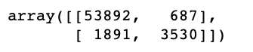
Performance Measures - Confusion Matrix
# Get the predicted values
>>> from sklearn.model_selection import cross_val_predict
>>> y_train_pred = cross_val_predict(sgd_clf, X_train, y_train_5, cv=3)
# Confusion matrix of 5-detector
>>> from sklearn.metrics import confusion_matrix
>>> confusion_matrix(y_train_5, y_train_pred)
Confusion Matrix of 5-detector
Notes:
100 by 105 which is approximately 0.95.

Slide 105
Performance Measures - Confusion Matrix
# Get Precision Score of 5-detector
>>> from sklearn.metrics import precision_score, recall_score
>>> precision_score(y_train_5, y_train_pred)
Precision Score of 5-detector
Notes:
100 by 105 which is approximately 0.95.

Slide 106
Performance Measures - Confusion Matrix
# Get Recall Score of 5-detector
>>> recall_score(y_train_5, y_train_pred)
Recall Score of 5-detector
Notes:
100 by 105 which is approximately 0.95.

Slide 107
Performance Measures - Confusion Matrix
Precision = 83 %
Recall = 65 %
Correct only 83% of time
Detects only 65% of 5s
Precision / Recall Score of 5-detector
Notes:
100 by 105 which is approximately 0.95.

Slide 108
Steps
Divide dataset into training and test samples
Train the classifier using training dataset
Test using sample data - some_digit
Performance metrics (Finalize the model)
Cross Validation - Accuracy
Confusion Matrix
Precision
Recall
F1 Score
ROC Curve
Notes:
100 by 105 which is approximately 0.95.

Slide 109
Performance Measures - F1 Score
Instead of computing precision and recall every time
We prefer a single metric which combines both precision and recall
This single metric is f1 score
Notes:
100 by 105 which is approximately 0.95.

Slide 110
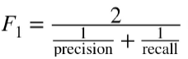
Performance Measures - F1 Score
F1 score is harmonic mean of precision and recall
Notes:
100 by 105 which is approximately 0.95.

Slide 111

Performance Measures - F1 Score
Precision
Recall
F1 score
F1 score is high when both Precision and Recall are almost similar
Notes:
Instead of computing precision and recall every time we train a classifier, we prefer a single metric which combines both precision and recall. This single metric is f1 score.
F1 score favors the classifiers that have similar precision and recall.

Slide 112
Performance Measures - F1 Score
# Get f1 score of 5-detector
>>> from sklearn.metrics import f1_score
>>> f1_score(y_train_5, y_train_pred)
F1 Score of 5-detector
Notes:
In the high recall, the security guard might catch and examine some non shoplifters also but we will achieve our goal of catching almost all the shoplifters.

Slide 113
Performance Measures - Precision / Recall Tradeoff
Now you may think that we can have both high precision and high recall in a model. But unfortunately, we can’t have both high precision and high recall at the same time.
Precision
Recall
Notes:
Now you may think that we can have both high precision and high recall in a good model. But unfortunately, we can’t have both high precision and high recall at the same time.

Slide 114
Performance Measures - Precision / Recall Tradeoff
Precision
Recall
Precision
Recall
Precision / Recall Tradeoff
Notes:
precision recall tradeoff. Let’s understand this tradeoff.

Slide 115
Performance Measures - Precision / Recall Tradeoff
To understand this tradeoff, lets see how SGDClassifier works
Notes:
else to the negative class. Here again the threshold is decided by the classification algorithm.

Slide 116
Performance Measures - Precision / Recall Tradeoff
Score > Threshold
Decision Score
Yes
“5” - Positive Class
Training Set
model
No
“Not 5” - Negative Class
Threshold - decided by the classification algorithm
Notes:
else to the negative class. Here again the threshold is decided by the classification algorithm.

Slide 117
Precision / Recall Tradeoff - Thresholds
Scikit enables the user to get the scores from the classifier
Calculating the decision function score for the SGDClassifier
>>> y_scores = sgd_clf.decision_function([some_digit])
>>> y_scores
array([2164.22030239])

Slide 118
Precision / Recall Tradeoff
Increasing precision reduces recall and vice-versa
Raising the threshold, decreases recall
For ‘5’ and ‘Not 5’ classifier
For threshold = 0, classifier correctly classifies 5 as 5
>>> threshold = 0
>>> y_some_digit_pred = (y_scores > threshold)
>>> y_some_digit_pred
array([ True])
Run it on Notebook

Slide 119
Precision / Recall Tradeoff
Increasing precision reduces recall and vice-versa
Raising the threshold, decreases recall
For ‘5’ and ‘Not 5’ classifier
For threshold = 0, classifier correctly classifies 5 as 5
For threshold = 8000, classifier incorrectly classifies digit 5 as not 5
# Setting the threshold to 8000
>>> threshold = 8000
>>> y_some_digit_pred = (y_scores > threshold)
>>> y_some_digit_pred
array([False])
Run it on Notebook

Slide 120
Review of Precision/ Recall Tradeoff
Hence, by selecting an appropriate threshold, the user can obtain the desired precision. However, the best precision may not have the best recall.

Slide 121
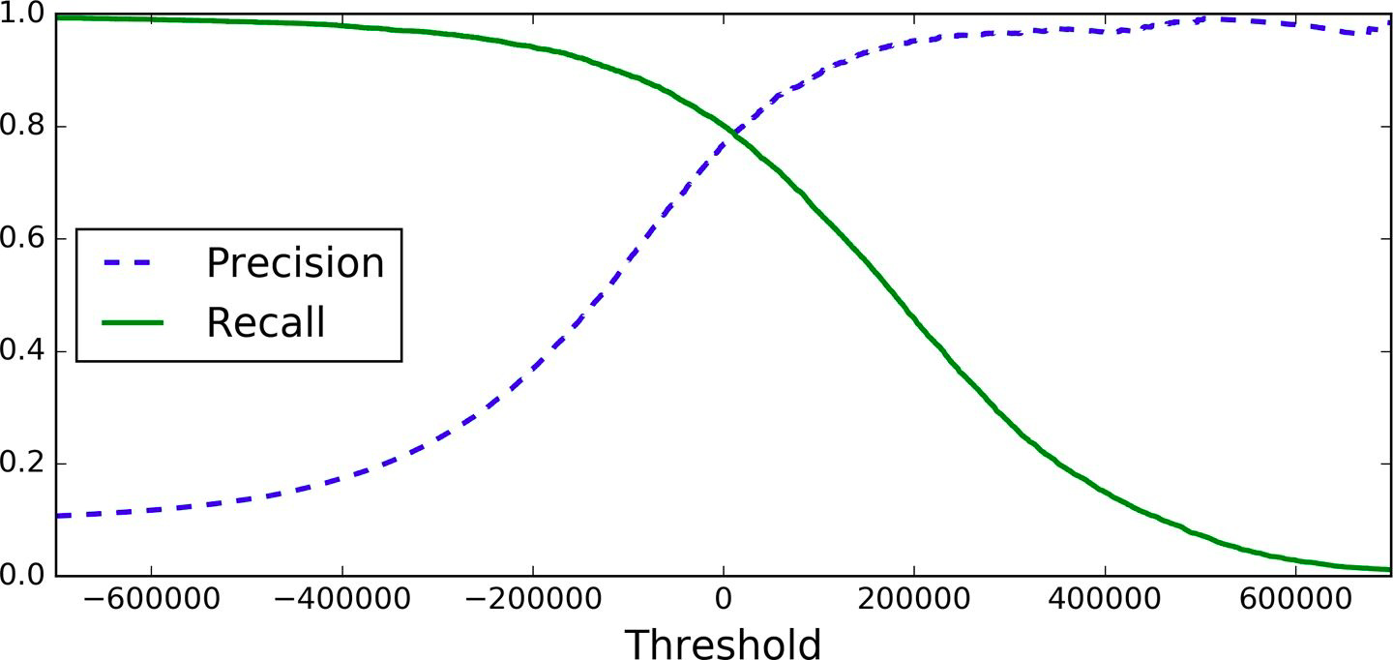
Precision / Recall Curve
Precision and recall versus the decision threshold
Precision Recall Curve of 5-detector

Slide 122
Precision / Recall Curve
Precision
Recall
Precision and recall versus the decision threshold
Notes:
As we can see if we increase the threshold, the precision increases and

Slide 123
Precision / Recall Curve
Recall
Precision
Precision and recall versus the decision threshold
Notes:
And, if we decrease the threshold,

Slide 124
Precision / Recall Curve
Which threshold value to use?
Notes:
So how do we decide which threshold value to use? The answer is we can simply select the threshold value which gives us the best precision-recall threshold for our task. Say for our task we need high precision then

Slide 125
Precision / Recall Curve
90% Precision
Set threshold to 400000
Select the threshold to achieve 90% precision
Notes:
To achieve the same we set the threshold to around four hundred thousand.

Slide 126
Precision / Recall Curve Using Scikit-learn
Plot Precision / Recall Curve
Get the scores of all the training dataset using cross_val_predict with decision_function as function
Compute the precision and recall for all possible thresholds using precision_recall_curve()
Plot both precision and recall for the thresholds using matplotlib
Select the threshold value that gives the best precision/ recall tradeoff to the task at hand.

Slide 127
Precision / Recall Curve Using Scikit-learn
Calculating precision/ recall curve using Scikit-Learn
>>> y_scores = cross_val_predict(sgd_clf, X_train, y_train_5, cv=3, method="decision_function")
>>> from sklearn.metrics import precision_recall_curve
precisions, recalls, thresholds = precision_recall_curve(y_train_5, y_scores)
Run it on Notebook

Slide 128
Precision / Recall Curve Using Scikit-learn
Plotting precision/ recall curve using Scikit-Learn
>>> def plot_precision_recall_vs_threshold(precisions, recalls, thresholds):
plt.plot(thresholds, precisions[:-1], "b--", label="Precision", linewidth=2)
plt.plot(thresholds, recalls[:-1], "g-", label="Recall", linewidth=2)
plt.legend(loc="center right", fontsize=16)
plt.xlabel("Threshold", fontsize=16)
plt.grid(True)
plt.axis([-50000, 50000, 0, 1])
plt.figure(figsize=(8, 4))
>>> plot_precision_recall_vs_threshold(precisions, recalls, thresholds)
>>> plt.show()
Run it on Notebook

Slide 129
Precision / Recall Curve
Plotting precision/ recall curve using Scikit-Learn

Slide 130
Building model with desired precision
So let’s say you want to build a classifier with 90% precision
Then first select the threshold value which gives you 90% precision
Then build classifier using this threshold
>>> threshold_90_precision = thresholds[np.argmax(precisions >= 0.90)]
>>> y_train_pred_90 = (y_scores >= threshold_90_precision)
This classifier will give 90% precision
Run it on Notebook

Slide 131
Building model with desired precision
Verify it
>>> precision_score(y_train_5, y_train_pred_90)
0.9000380083618396
>>> recall_score(y_train_5, y_train_pred_90)
0.4368197749492714
Run it on Notebook

Slide 132


I want a model with 99% precision
Boss
ML Engineer
Notes:
So if your boss asks you to reach 99% precision, you should

Slide 133
At what recall? :)
Boss
ML Engineer
Notes:
ask him at what recall :)

Slide 134

Say we have to build a model which detects if a video is safe for kids or not.
Question - High Precision or High Recall?
Notes:
Say we have to build a model which detects if a video is safe for kids or not.

Slide 135
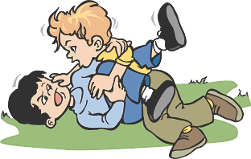


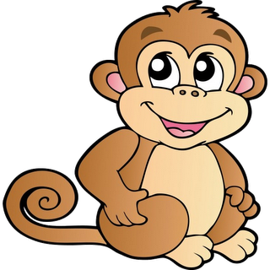
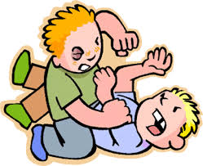
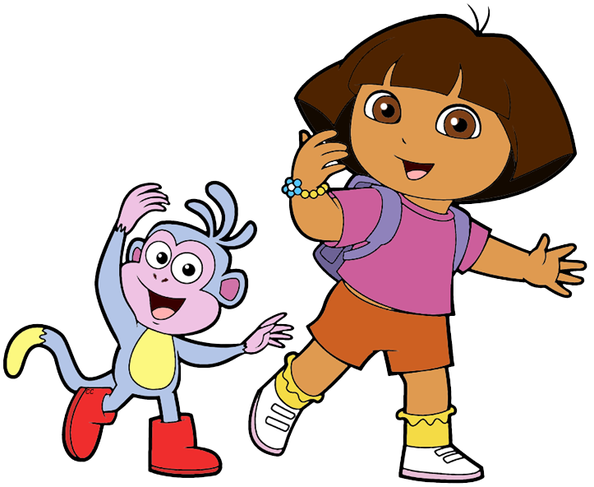
High Precision or High Recall?
High precision means if the model classifies video 4 and video 6 as safe for kids, they are actually safe for kids.
1 - Not Safe
2 - Safe
3 - Not Safe
4 - Safe
5 - Not Safe
6 - Safe
High Precision
Notes:
High precision means if the model classifies video 4 and video 6 as safe for kids, they are actually safe for kids.

Slide 136
High Precision or High Recall?
In high precision, we are okay if the model is not able to classify video 2 as safe for kids but whichever videos it classifies as safe for kids they are actually safe.
1 - Not Safe
2 - Safe
3 - Not Safe
4 - Safe
5 - Not Safe
6 - Safe
High Precision
High Precision
Notes:
In high precision, we are okay if the model is not able to classify video 2 as safe for kids but whichever videos it classifies as safe for kids they are actually safe.

Slide 137
High Precision or High Recall?
We would prefer a model which has high precision and low recall. It is okay if the model rejects many good videos but keeps only really safe ones
1 - Not Safe
2 - Safe
3 - Not Safe
4 - Safe
5 - Not Safe
6 - Safe
High Precision, Low Recall
Notes:
We would prefer a model which has high precision and low recall. It is okay if the model rejects many good videos but keeps only really safe ones, instead of

Slide 138

Say we have to build a model which detects shoplifters on the basis of surveillance image. In case, someone is marked as shoplifter, we manually examine.
Question - High Precision or High Recall?
Notes:
Let’s see one more example. Say we have to build a model which detects shoplifters on the basis of surveillance images. In case, someone is marked as shoplifter, we manually examine.

Slide 139


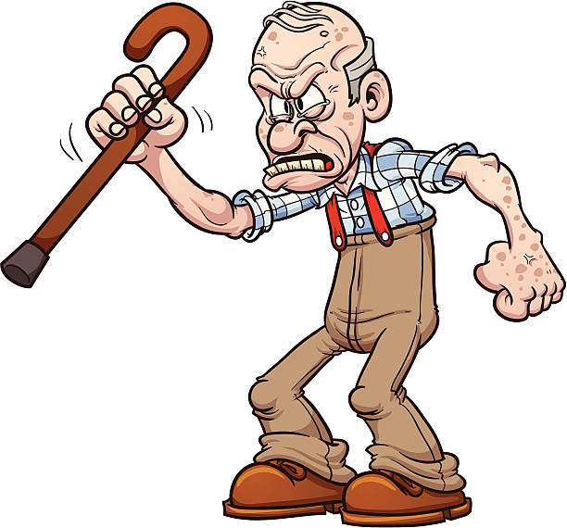

High Precision or High Recall?
We would prefer the model to have high recall even if the precision is low because our goal is to catch almost all the shoplifters.
High Recall
Notes:
We would prefer the model to have high recall even if the precision is low because our goal is to catch almost all the shoplifters.

Slide 140
High Precision or High Recall?
In the high recall, the security guard might catch and examine some non shoplifters also but we will achieve our goal of catching almost all the shoplifters.
High Recall
Notes:
In the high recall, the security guard might catch and examine some non shoplifters also but we will achieve our goal of catching almost all the shoplifters.

Slide 141
Steps
Divide dataset into training and test samples
Train the classifier using training dataset
Test using sample data - some_digit
Performance metrics (Finalize the model)
Cross Validation - Accuracy
Confusion Matrix
Precision
Recall
F1 Score
ROC Curve

Slide 142
The ROC (Receiver Operating Characteristic) Curve
Notes:
Let’s understand one more measure of performance for binary classifiers, the ROC Curve - Receiver Operating Characteristic curve. Before understanding the ROC curve let’s understand two more terms associated with the confusion matrix.

Slide 143
Performance Measures - ROC Curve
Is helpful in comparing performances of different models
Let see ROC Curve of two different models
SGD Classifier
Random Forest Classifier
Before that lets learn about “Area Under the Curve”
Notes:
Here is the confusion matrix of the model which predicts if someone has cancer or not.

Slide 144
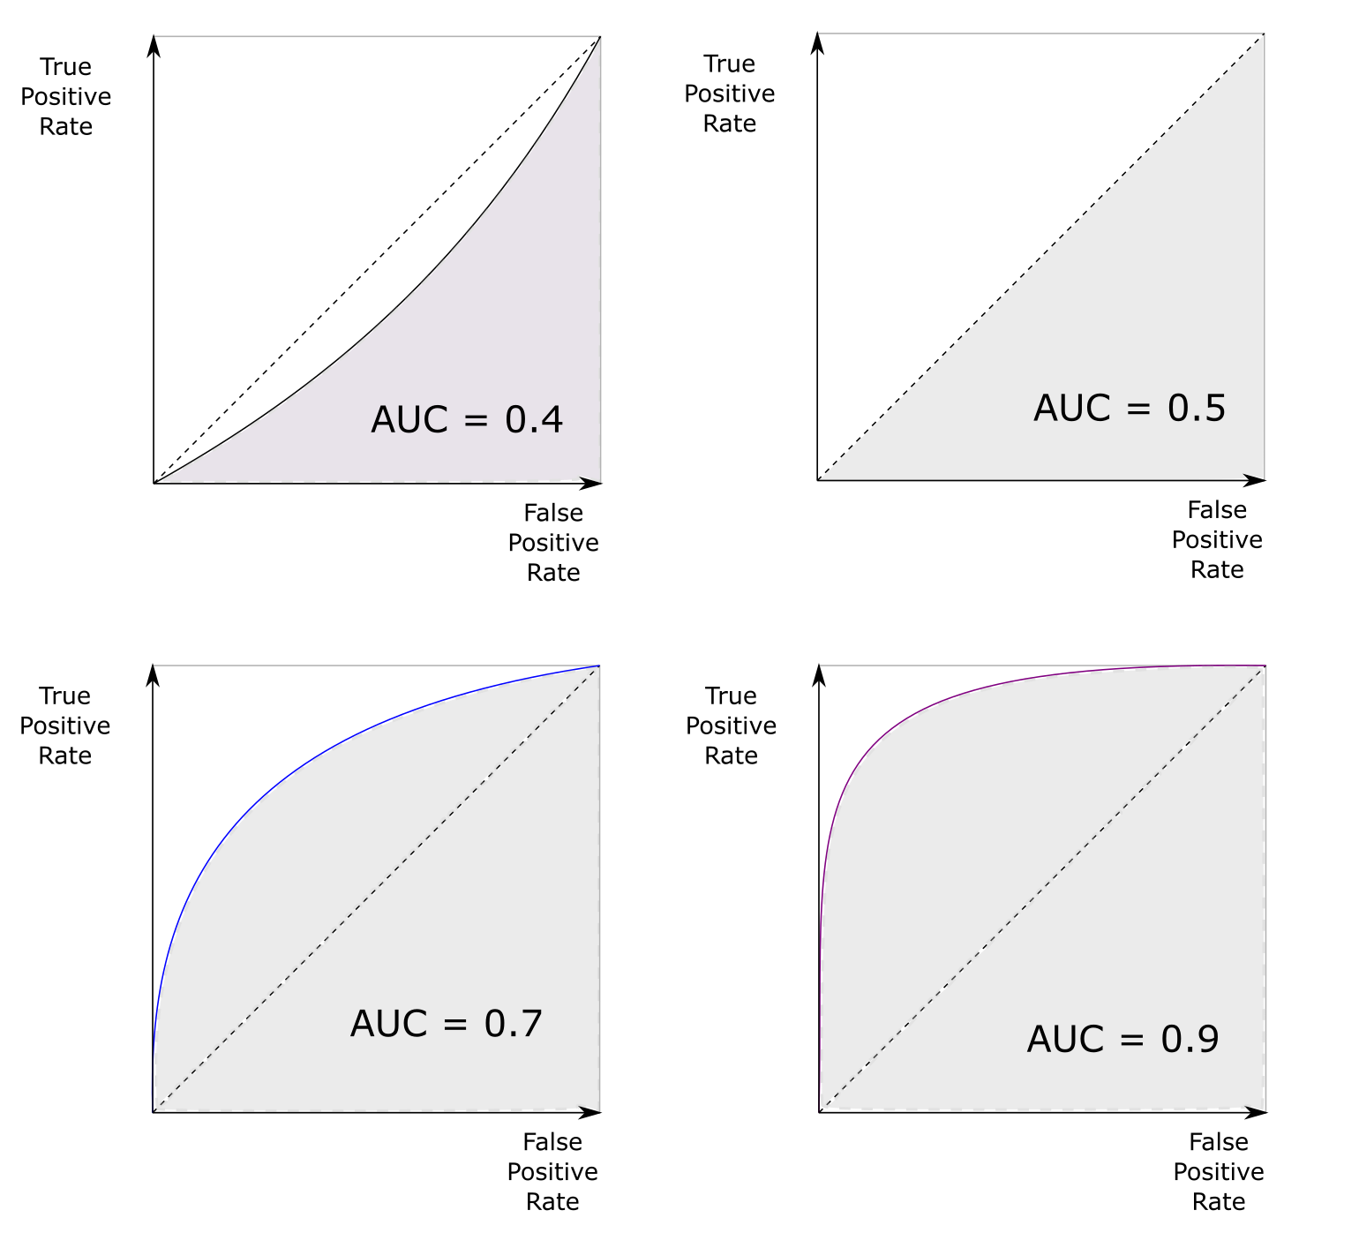
Performance Measures - ROC Curve
Higher the area under the curve, better the model is
Bad Model
Random Classifier. 50 % “5”. 50% “Not 5”
Nearly Perfect Model
Better Model
AUC - Area Under the Curve
Notes:
We can use ROC curves to compare various classifiers. One way to compare classifiers is to measure the area under the curve (AUC). Higher the area under the curve, better the model is. A purely random classifier have the area under the curve equal

Slide 145
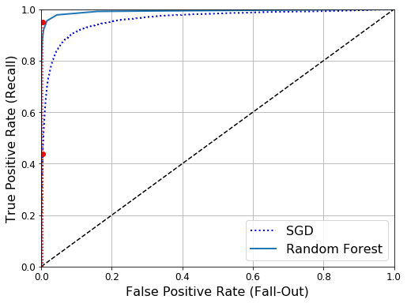
Performance Measures - ROC Curve
Area Under the Curve is higher for Random Forest, so its better model than SGD
ROC Curve of 5 Detector for SGD and Random Forest
Notes:
Here is the confusion matrix of the model which predicts if someone has cancer or not.

Slide 146
Performance Measures - ROC Curve
Predicted
TN
FP
 | Cancer - No | Cancer - Yes
Cancer - No | 50 | 10
Cancer - Yes | 5 | 100
Actual
FN
TP
Notes:
Here is the confusion matrix of the model which predicts if someone has cancer or not.

Slide 147
Performance Measures - ROC Curve
Predicted
TN
FP
 | Cancer - No | Cancer - Yes
Cancer - No | 50 | 10
Cancer - Yes | 5 | 100
Actual
Recall or True Positive Rate = 100 out of 105 = 0.95
Notes:
Recall is also known as the true positive rate.

Slide 148
Performance Measures - ROC Curve
Predicted
TN
FP
 | Cancer - No | Cancer - Yes
Cancer - No | 50 | 10
Cancer - Yes | 5 | 100
Actual
Total Patients not Having Cancer = 60
False Positive Rate tells us what proportion of patients that actually were not having cancer are classified as having cancer by the model.
Notes:
actually were not having cancer are classified as

Slide 149
Performance Measures - ROC Curve
Predicted
TN
FP
 | Cancer - No | Cancer - Yes
Cancer - No | 50 | 10
Cancer - Yes | 5 | 100
Actual
Model Prediction as having cancer = 10
False Positive Rate tells us what proportion of patients that actually were not having cancer are classified as having cancer by the model.
Notes:
having cancer by the model.

Slide 150
Performance Measures - ROC Curve
Predicted
TN
FP
 | Cancer - No | Cancer - Yes
Cancer - No | 50 | 10
Cancer - Yes | 5 | 100
Actual
False Positive Rate = 10 out of 60 = 0.17
False Positive Rate tells us what proportion of patients that actually were not having cancer are classified as having cancer by the model.
Notes:
Here, the false positive rate is 10 out of 60 which is 0.17

Slide 151
Divide dataset into training and test samples
Train the classifier using training dataset
Test using sample data - some_digit
Performance metrics (Finalize the model)
Cross Validation - Accuracy
Confusion Matrix
Precision
Recall
F1 Score
ROC Curve
Notes:
Hopefully, now you have a fair understanding of which performance measure to choose, select the precision/recall tradeoff that fits your needs and compare various classifiers using ROC curves and area under the curve.

Slide 152
Multiclass Classification
So far we have discussed 5-detector. Let’s come back to the original problem

Slide 153

Multiclass Classification
Classify Handwritten Digits - Which is a MultiClass Problem

Slide 154
Multiclass Classification
Multiclass Classifier Using SGDClassifier
>>> sgd_clf.fit(X_train, y_train)
>>> sgd_clf.predict([some_digit])

Slide 155
Multiclass Classification
Check Accuracy Using Cross Validation
>>> cross_val_score(sgd_clf, X_train, y_train, cv=3, scoring="accuracy")

Slide 156
Multiclass Classification
Improving Accuracy by Scaling the Features
>>> from sklearn.preprocessing import StandardScaler
>>> scaler = StandardScaler()
>>> X_train_scaled = scaler.fit_transform(X_train.astype(np.float64))
>>> cross_val_score(sgd_clf, X_train_scaled, y_train, cv=3, scoring="accuracy")

Slide 157
What do we do next?
Completed:
Binary Classification
Multi-class Classification
Next:
Multi-label Classification
Multi-output Classification

Slide 158
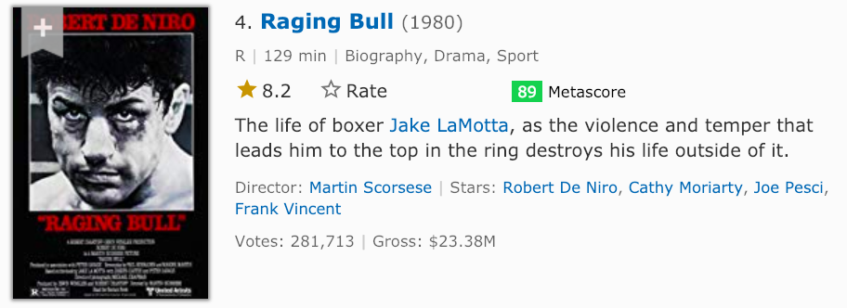
Multilabel Classification
Output multiple classes
BioGraphy | 1
Drama | 1
Sport | 1
Sci-fi | 0
Multiple Classes
Categories in which model is trained
Notes:
Then for the raging bull movie such a multilabel classifier will output multiple binary label, one for each class.

Slide 159
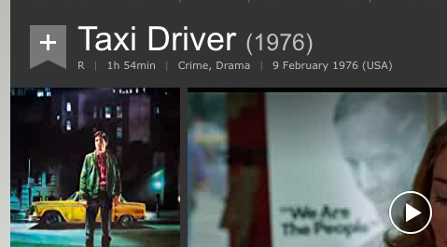
Multilabel Classification
Output multiple classes
BioGraphy | 0
Drama | 1
Sport | 0
Sci-fi | 0
Multiple Classes
Categories in which model is trained
Notes:
Then for the raging bull movie such a multilabel classifier will output multiple binary label, one for each class.

Slide 160
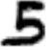
Multilabel Classification
Build a model to classify an image into two classes
Greater than or equal to 7
Is Odd
Is it large? - False
Is it odd? - True
Classifier’s output will be - [False, True]

Slide 161
Multilabel Classification - Example
Classification of image into whether [large, odd], how do we do it?
Get the new labels
Train the classifier
Test using sample data - some_digit

Slide 162
Multilabel Classification - Example
Step 1: Get the new labels
>>> y_train_large = (y_train >= 7)
>>> y_train_odd = (y_train % 2 == 1)
>>> y_multilabel = np.c_[y_train_large, y_train_odd] # np.c_ is used to concatenate the two arrays element wise
Run it on Notebook

Slide 163
Multilabel Classification
Step 2: Train the model
KNeighbors Classifier supports multi-label, classification
Get the new labels
Train the classifier
Test using sample data - some_digit
>>> from sklearn.neighbors import KNeighborsClassifier
>>> knn_clf = KNeighborsClassifier()
>>> knn_clf.fit(X_train, y_multilabel)
Run it on Notebook

Slide 164
Multilabel Classification
Step 3: Test it
Get the new labels
Train the classifier
Test using sample data - some_digit
>>> knn_clf.predict([some_digit])
array([[False, True]], dtype=bool)
Digit 5 is not large (i.e. it not 7 or 8 or 9) but is odd

Slide 165
Multioutput Classification
It is simply a generalization of multilabel classification where each label can be multiclass (i.e., it can have more than two possible values)
Multi-output classification example - Removing noise from images

Slide 166
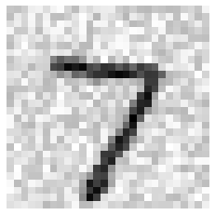

Multioutput Classification
We'll build a model that removes noise from images. It will take as input a noisy digit image, and it will output a clean digit image, represented as an array of pixel intensities, just like the MNIST images.
Model
Cleaned Image
Input Image with Noise

Slide 167
Multioutput Classification
Notice that the models’ output is
Multilabel (one label per pixel) - so 784 labels
Multiclass: And each label can have multiple values (pixel intensity ranges from 0 to 255) - 256 classes.
Model
Cleaned Image
Input Image with Noise

Slide 168
Multioutput Classification
28 Columns
144 Pixel 11 | 200 Pixel 12 | 64 Pixel 13
94 Pixel 21 | 105 Pixel 22 | 74 Pixel 23
149 Pixel 31 | 200 Pixel 32 | 123 Pixel 33
28 Rows
Each pixel can have values in the range of 0 and 255

Slide 169
Multioutput Classification
Hands-on - image noise removal
Adding noise to the training set
>>> import numpy.random as rnd
>>> noise_train = rnd.randint(0, 100, (len(X_train), 784))
>>> X_train_mod = X_train + noise_train
Run it on Notebook

Slide 170
Multioutput Classification
Hands-on - image noise removal
Adding noise to the test set
>>> noise_test = rnd.randint(0, 100, (len(X_test), 784))
>>> X_test_mod = X_test + noise_test
Run it on Notebook

Slide 171
Multioutput Classification
Hands-on - image noise removal
Setting clean image as the label (y_train and y_test)
>>> y_train_mod = X_train
>>> y_test_mod = X_test
Run it on Notebook

Slide 172
Multioutput Classification
Hands-on - image noise removal
Let’s view the noise image at index 0
>>> some_index = 0
>>> plot_digit(X_test_mod[some_index])
Run it on Notebook

Slide 173
Multioutput Classification
Hands-on - image noise removal
Clean the image using the KNN Classifier
>>> knn_clf.fit(X_train_mod, y_train_mod)
Run it on Notebook

Slide 174
Multioutput Classification
Hands-on - image noise removal
View cleaned image at index 0
>>> clean_digit = knn_clf.predict([X_test_mod[some_index]])
>>> plot_digit(clean_digit)
Run it on Notebook

Slide 175
Review till now?
Divide dataset into training and test samples
Train the classifier using training dataset
Test using sample data - some_digit
Performance metrics (Finalize the model)
Binary Classification
Multiclass Classification
Multilabel
Multi-output
Cross Validation - Accuracy
Confusion Matrix
Precision
Recall
F1 Score
ROC Curve

Slide 176
Questions?
https://discuss.cloudxlab.com
reachus@cloudxlab.com

Slide 177
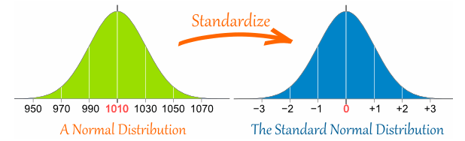
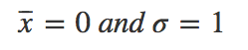
Feature Scaling - Standardization
Zero Mean
Unit Standard Deviation

Slide 178
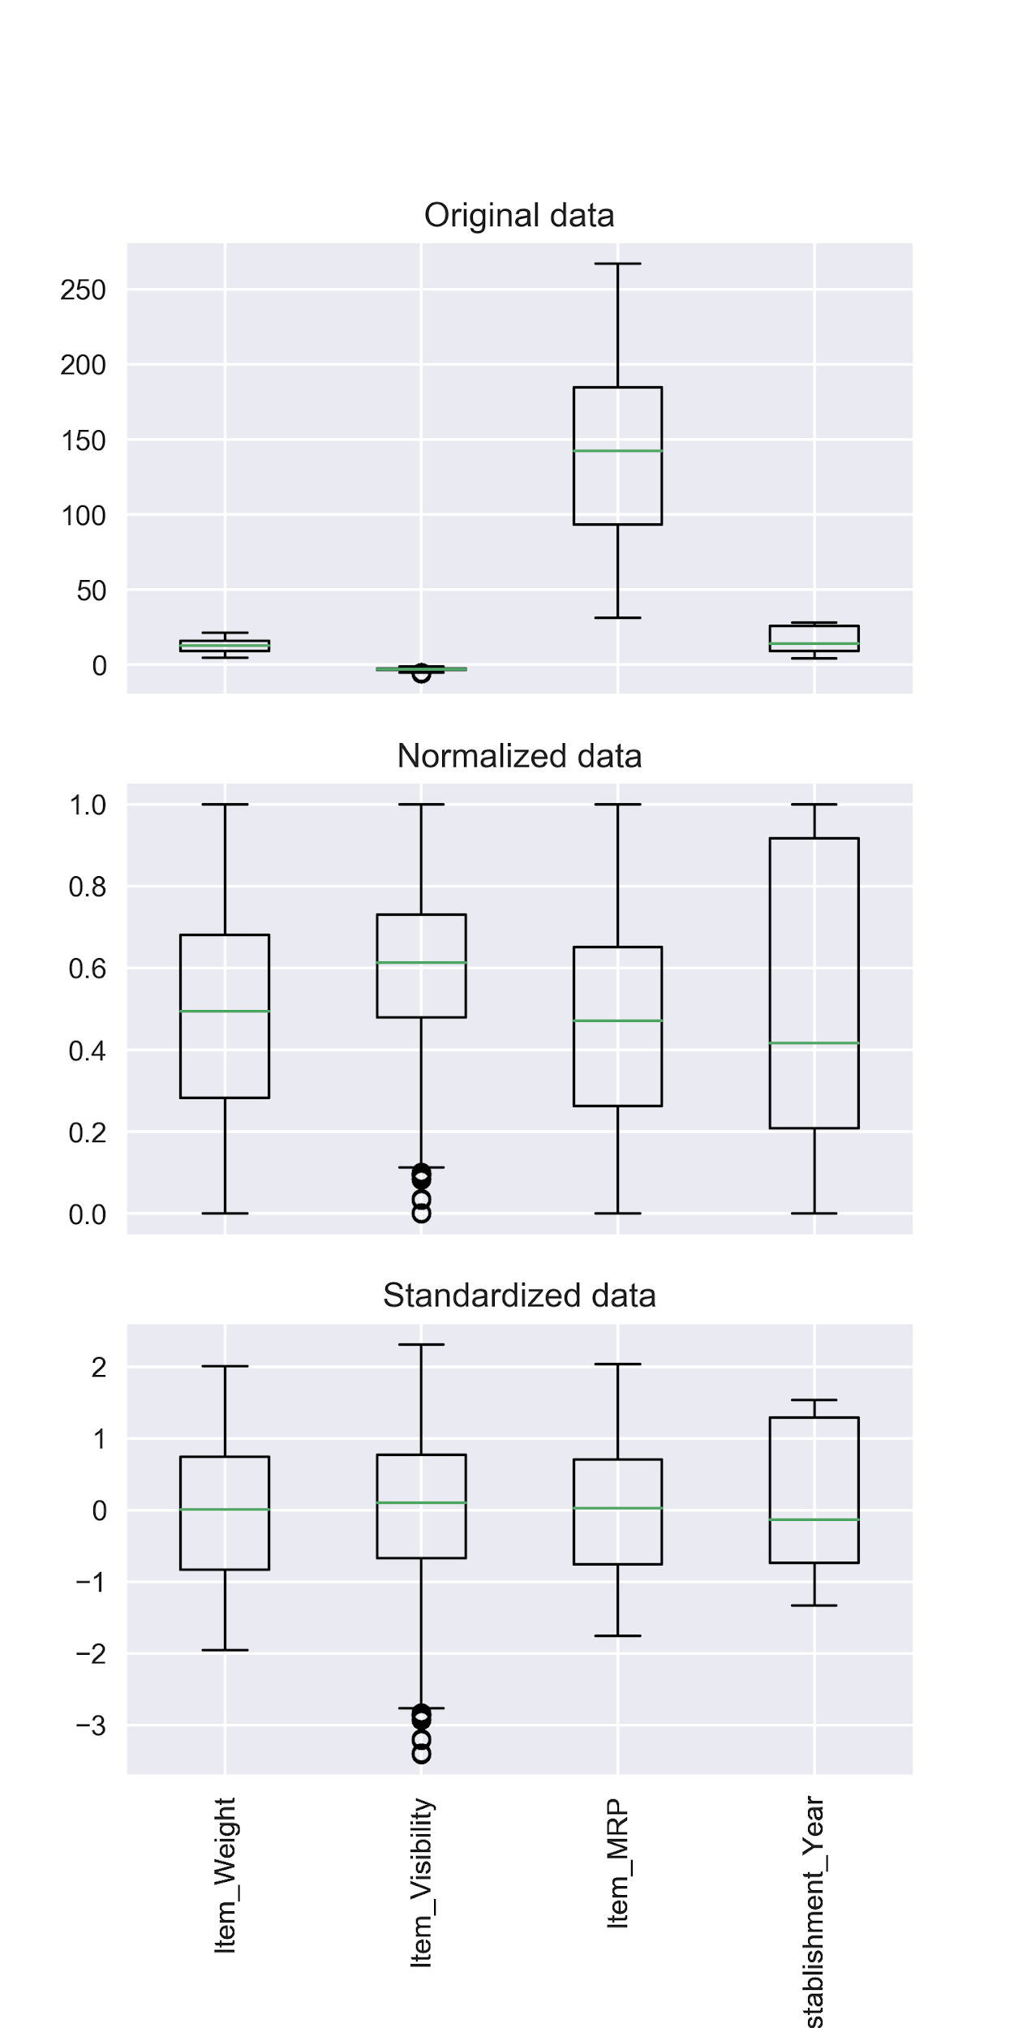
Feature Scaling - Standardization
Original Data
Normalized Data
Standardized Data

Slide 179
Cross Validation
Original Dataset
Training Set
Test Set
Divide Training Set in Two Parts
Smaller Training Set
Validation Set
For Training the Model
For Evaluating the Model
Notes:
…..and validation set. Basically, we split the smaller training set into folds.

Slide 180
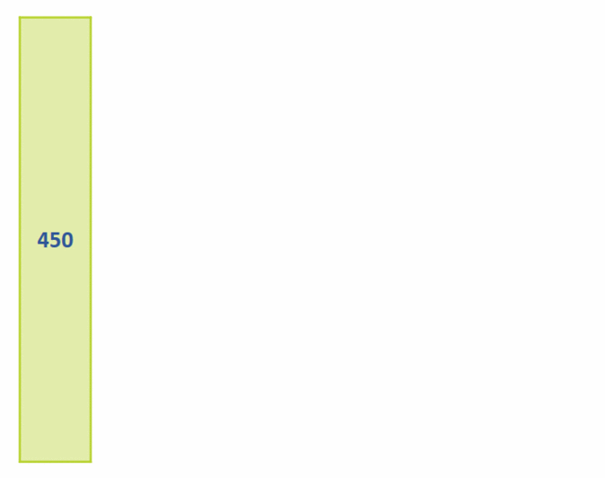
Cross Validation
With 10 Folds
Notes:
In each iteration, we pick one fold as test set and remaining records as the training.
If we choose the number of folds as 10 for a dataset having 450 records. There will be 10 iterations. In each iteration, we will pick one fold having 45 records as the test set and remaining 405 records as the training set. So, in each iteration we will be training on 90% percent of the data and 10% of the dataset will be used for validating.
In each of the 10 iterations, we will be measuring the performance. we compute the mean and standard deviation of the performance measured in 10 iterations. Next, we short-list the top three to five most promising models. Let’s go back to Boot ML.

Slide 181
Performance Measures - ROC Curve
ROC Curve Similar to F1 score but uses a different metric
Uses True Positive Rate (TPR) = Recall = TP / (TP + FN)
False Positive Rate (FPR) = FP / (FP + TN)
= 1 - True Negative Rate (TNR)
TNR = TN / (FP + TN)
Receiver Operating Characteristics (ROC) plots:
TPR versus FPR

Slide 182
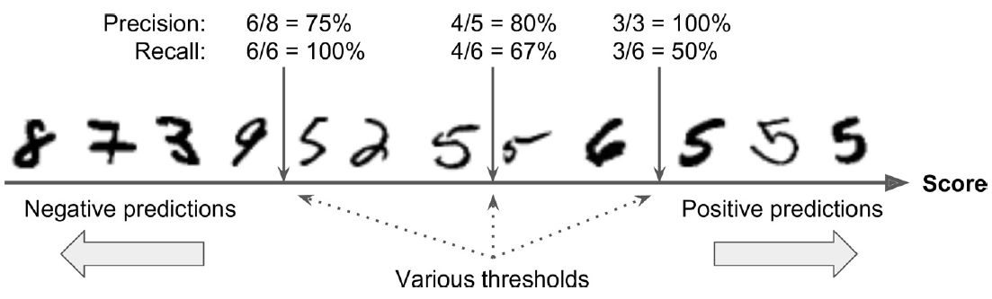
Precision / Recall Tradeoff - Thresholds
Thresholds can be set to achieve certain precision and recall as required

Slide 183
Precision / Recall Tradeoff
In this precision/recall trade-off, images are ranked by their classifier score, and those above the chosen decision threshold are considered positive; the higher the threshold, the lower the recall, but (in general) the higher the precision

Slide 184
Precision / Recall Tradeoff
In this precision/recall trade-off, images are ranked by their classifier score, and those above the chosen decision threshold are considered positive; the higher the threshold, the lower the recall, but (in general) the higher the precision

Slide 185
Precision / Recall Tradeoff
In this precision/recall trade-off, images are ranked by their classifier score, and those above the chosen decision threshold are considered positive; the higher the threshold, the lower the recall, but (in general) the higher the precision

Slide 186
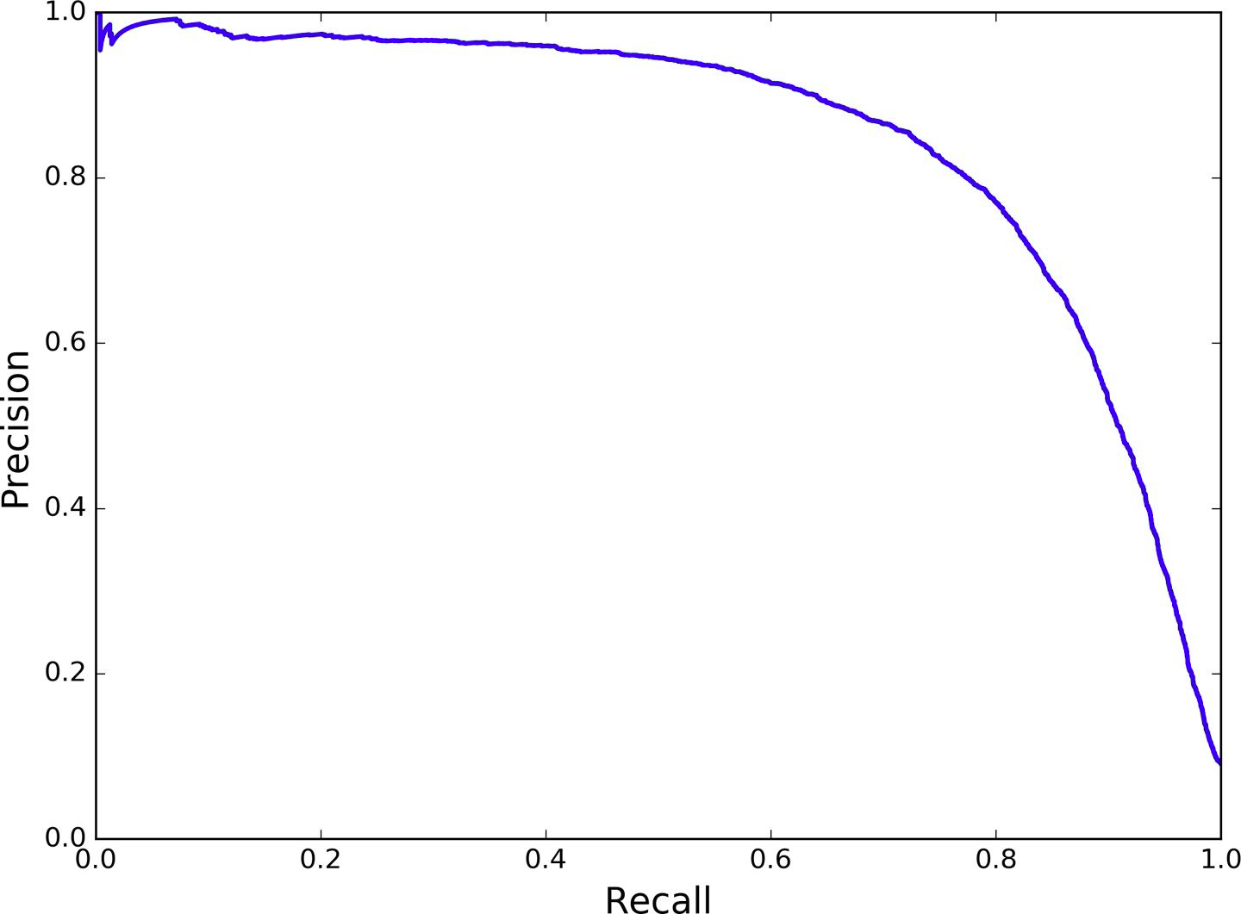
Precision vs Recall Curve
Another way to select a good precision/recall tradeoff is to
plot precision directly against recall.
Precision starts dropping sharply at 80% recall
Precision versus recall
Notes:
Another way to select good precision-recall tradeoff is to plot precision directly against the recall. As we can see, the precision drops sharply at 80% recall. We may select the precision-recall tradeoff just before the drop

Slide 187
Precision vs Recall Curve
Another way to select a good precision/recall tradeoff is to
plot precision directly against recall.
>>> def plot_precision_vs_recall(precisions, recalls):
plt.plot(recalls, precisions, "b-", linewidth=2)
plt.xlabel("Recall", fontsize=16)
plt.ylabel("Precision", fontsize=16)
plt.axis([0, 1, 0, 1])
plt.grid(True)
>>> plt.figure(figsize=(8, 6))
>>> plot_precision_vs_recall(precisions, recalls)
>>> plt.show()
Run it on Notebook

Slide 188
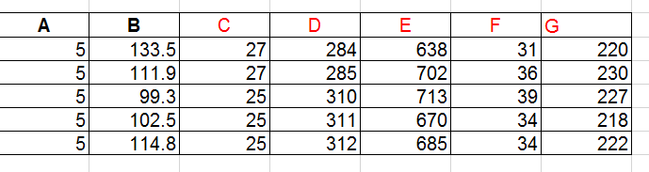
Another Example of Multioutput Classification
F, 37
C, 26

Slide 189

Performance Measures - F1 Score
F1 Score
Recall = 0.1
Precision = 0.9
Recall is really small compared to Precision
F1 score will be closer to the smaller number than the bigger one
Notes:
Then the f1 score will be closer to the smaller number than the bigger one

Slide 190
Performance Measures - F1 Score
F1 Score
Recall = 0.1
Precision = 0.9
Recall is really small compared to Precision
Hence F1 score is closer to Recall than Precision
Notes:
Then the f1 score will be closer to the smaller number than the bigger one

Slide 191
High Precision or High Recall?
High recall means the model will try to maximize the number of videos that are classified as safe.
1 - Not Safe
2 - Safe
3 - Not Safe
4 - Safe
5 - Not Safe
6 - Safe
High Recall
Notes:
High recall means the model will try to maximize the number of videos that are classified as safe.

Slide 192
High Precision or High Recall?
In high recall model may mistake while classifying video as safe. This is because recall is more about classifying all the “safe for kids” videos as “safe” rather than classifying all the videos correctly.
1 - Not Safe
2 - Safe
3 - Not Safe
4 - Safe
5 - Not Safe
6 - Safe
High Recall
Notes:
High recall means the model will try to maximize the number of videos that are classified as safe.

